Slide 1
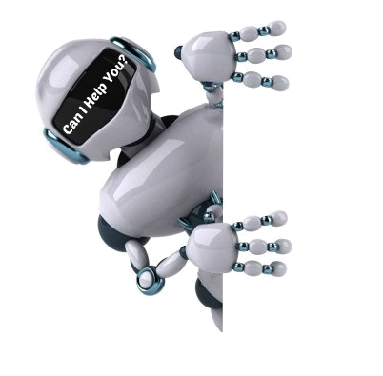
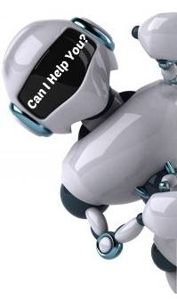


Conversational Dialogue Model (Chatbot)
Ain Shams University
Faculty of Computer and Information Sciences
Computer Science Department

Slide 2
Team Members
Ibrahim Sharaf CS
Abdelrahman Hamdy CS
Yousr Ahmed CS
Ahmed Gamal CS
Abdelhameed Hamed CS
Team Members
Prof.Dr Mostafa Aref
Dr. Wael Hamdy
TA. Zainab Fouad

Slide 3
Agenda
Introduction
Existing Solutions
System Architectures
Project Modules
Challenges Faced
Future work
Demo

Slide 4
Agenda
Introduction

Slide 5
Introduction
ITWORX Sponsorship
Problem Overview
Similar Work
Objectives

Slide 6
ITWORX Sponsorship
Accepted in ITWORX Graduation Projects Competition.
6 accepted teams out of ~350 teams.
Offering technical guidance and mentorship.

Slide 7
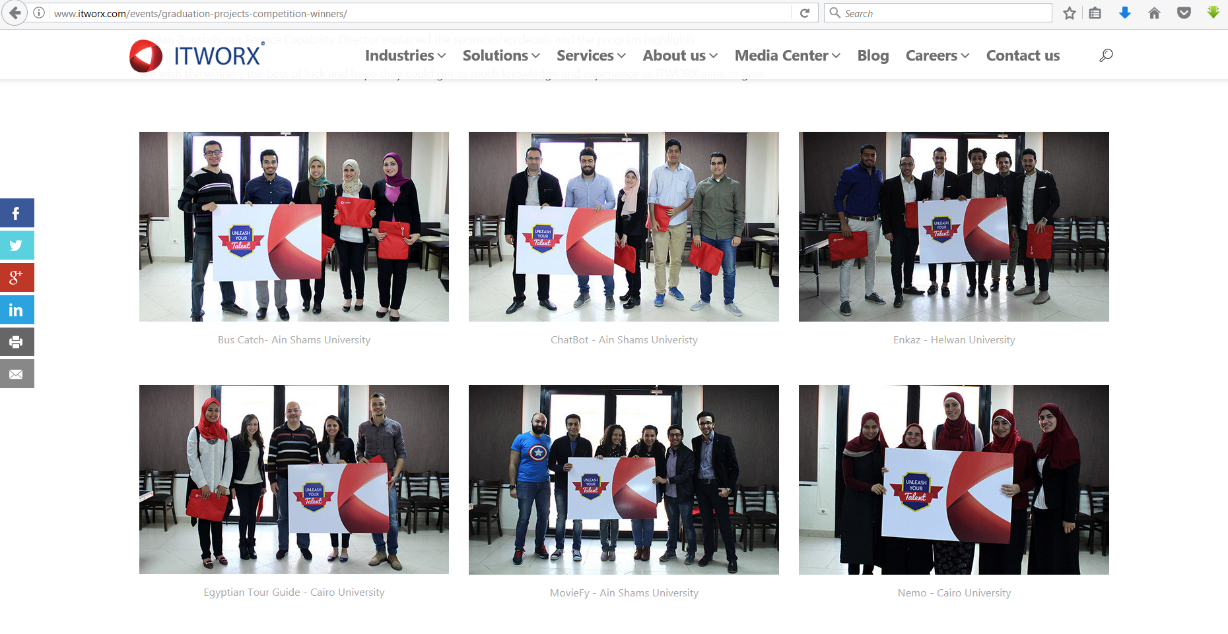
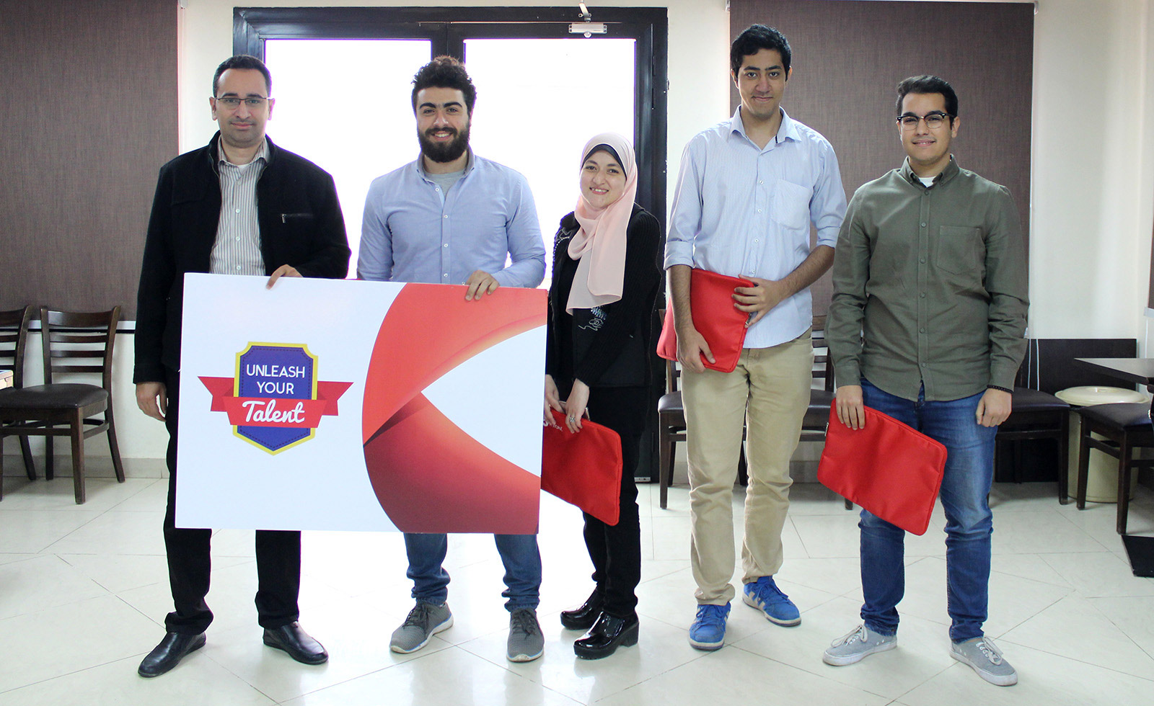
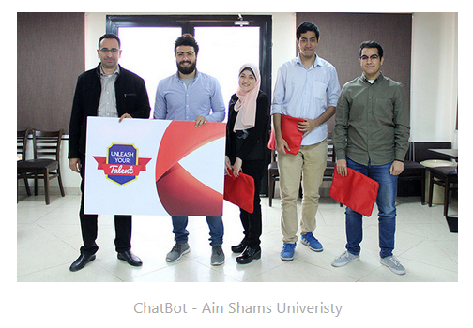
ITWORX Sponsorship

Slide 8
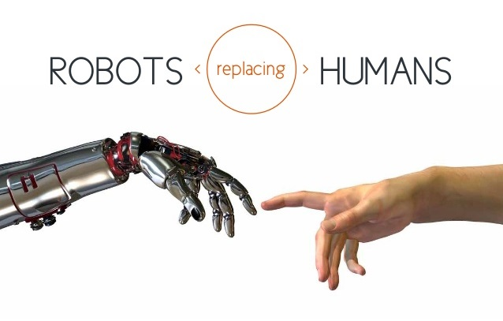
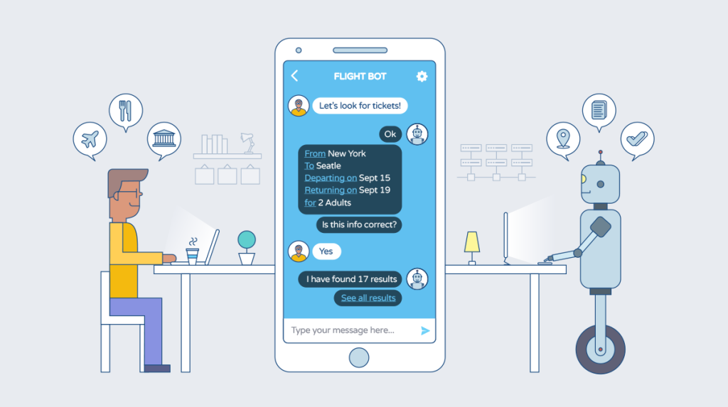
Problem Overview

Slide 9
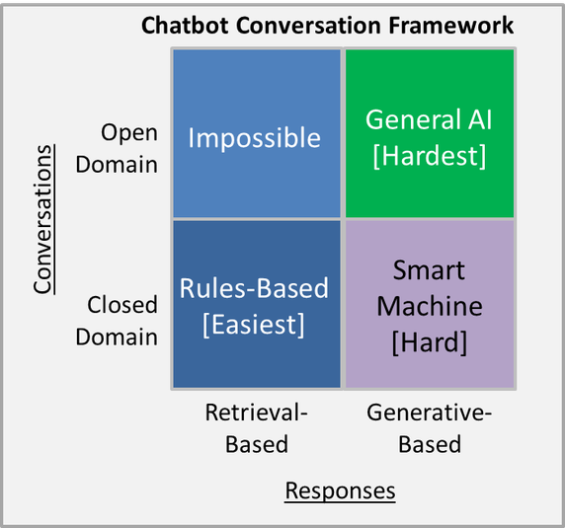
Types of ChatBots According to responses

Slide 10
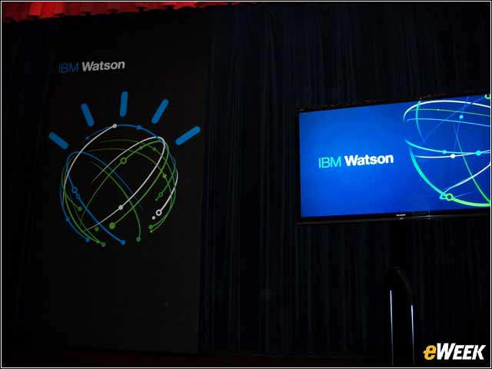



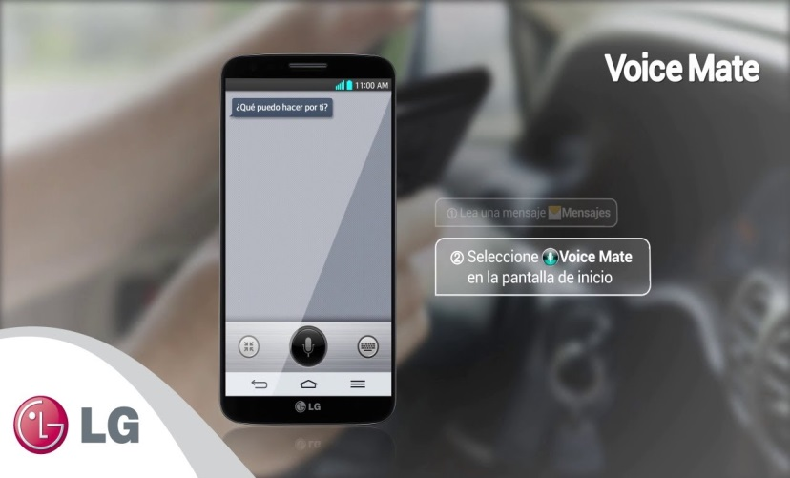

Examples Of ChatBots

Slide 11


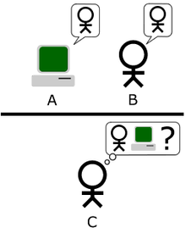
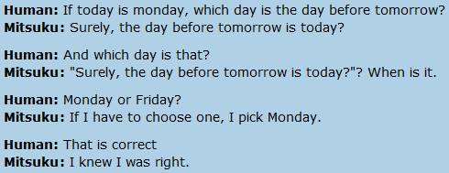

Slide 12
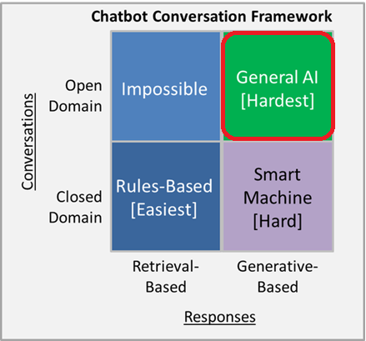
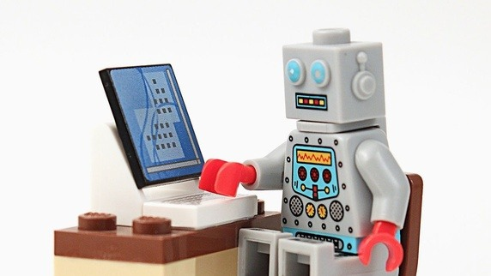
What’s The Type Of Our ChatBot
Strictly human-to-chatbot conversation: Open domain chatbot. To beat the Turing test — to become indistinguishable from humans during conversation.

Slide 13
Objectives
To build an open domain, conversational dialogue system based on large dialogue corpus using generative models.
To Find new ways to improve interactions between human and machine.
To beat the Turing test.

Slide 14
Agenda
Introduction
Existing Solutions

Slide 15
Existing Solutions
Google Model
Microsoft Model

Slide 16
Google Model
Paper: A Neural Conversational Model
By: Oriol Vinyals - Quoc V. Le QVL Data Set: open-domain movie transcript dataset: OpenSubtitles
Used Algorithm: the sequence-to-sequence model based on a recurrent neural network with long short-term memory.

Slide 17
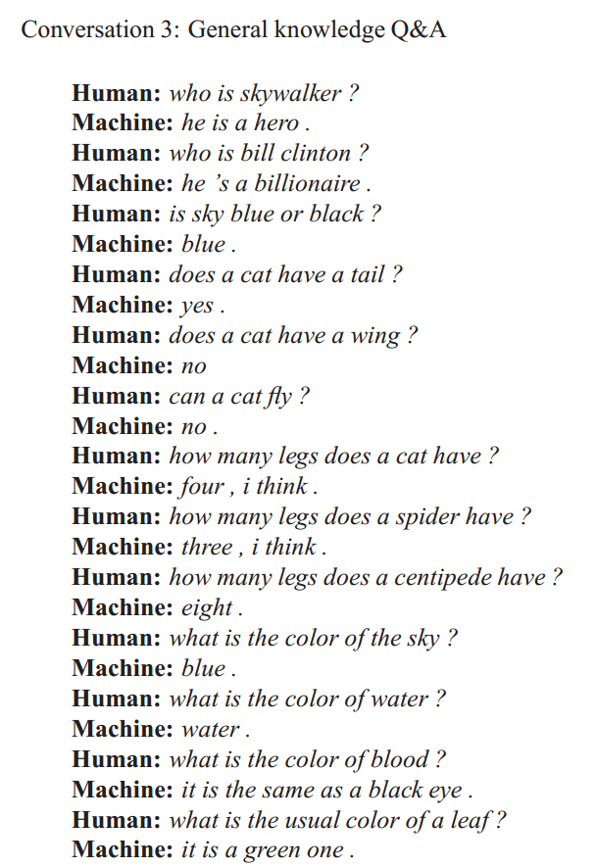
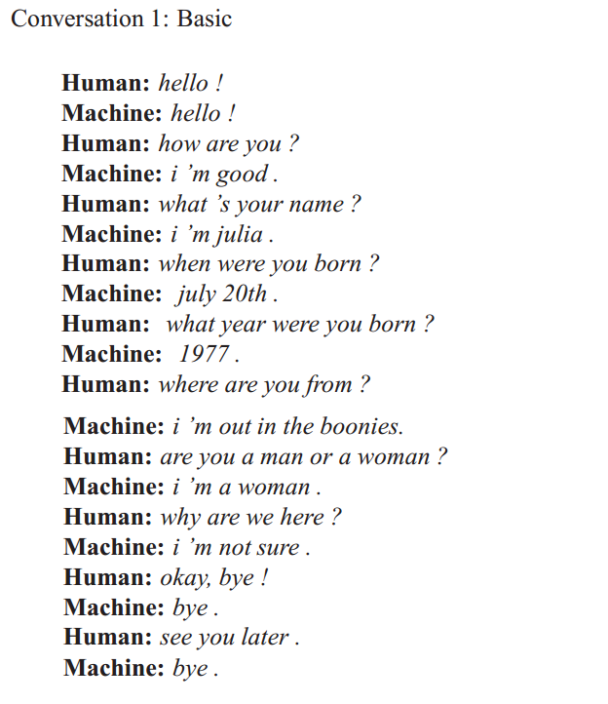
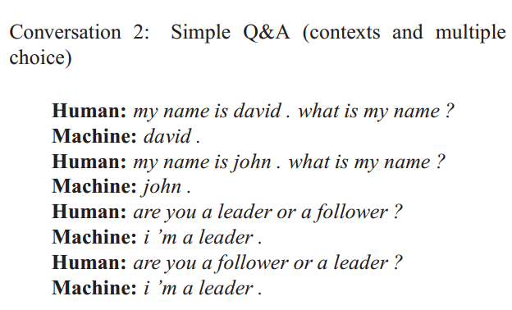
Google Model
Sample Output:

Slide 18
Microsoft Model
Paper: A Persona-Based Neural Conversation Model
By: Michel Galley - Chris Brockett Data Set: Twitter conversation snippets
Used Algorithm: the sequence-to-sequence model based on a recurrent neural network with long short-term memory.

Slide 19
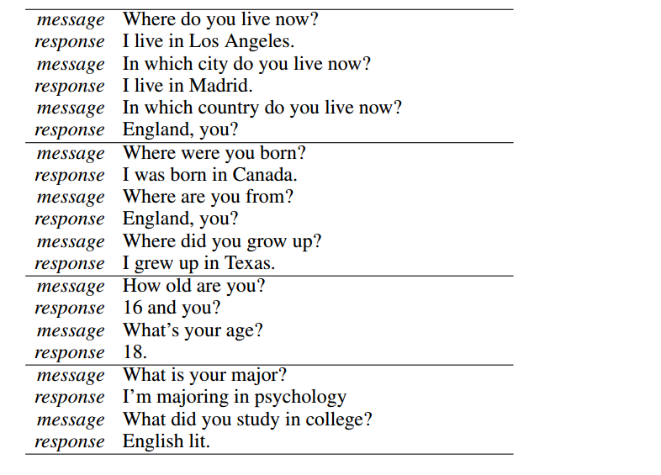
Microsoft Model
Sample Output:

Slide 20
Agenda
Introduction
Existing Solutions
System Architectures

Slide 21
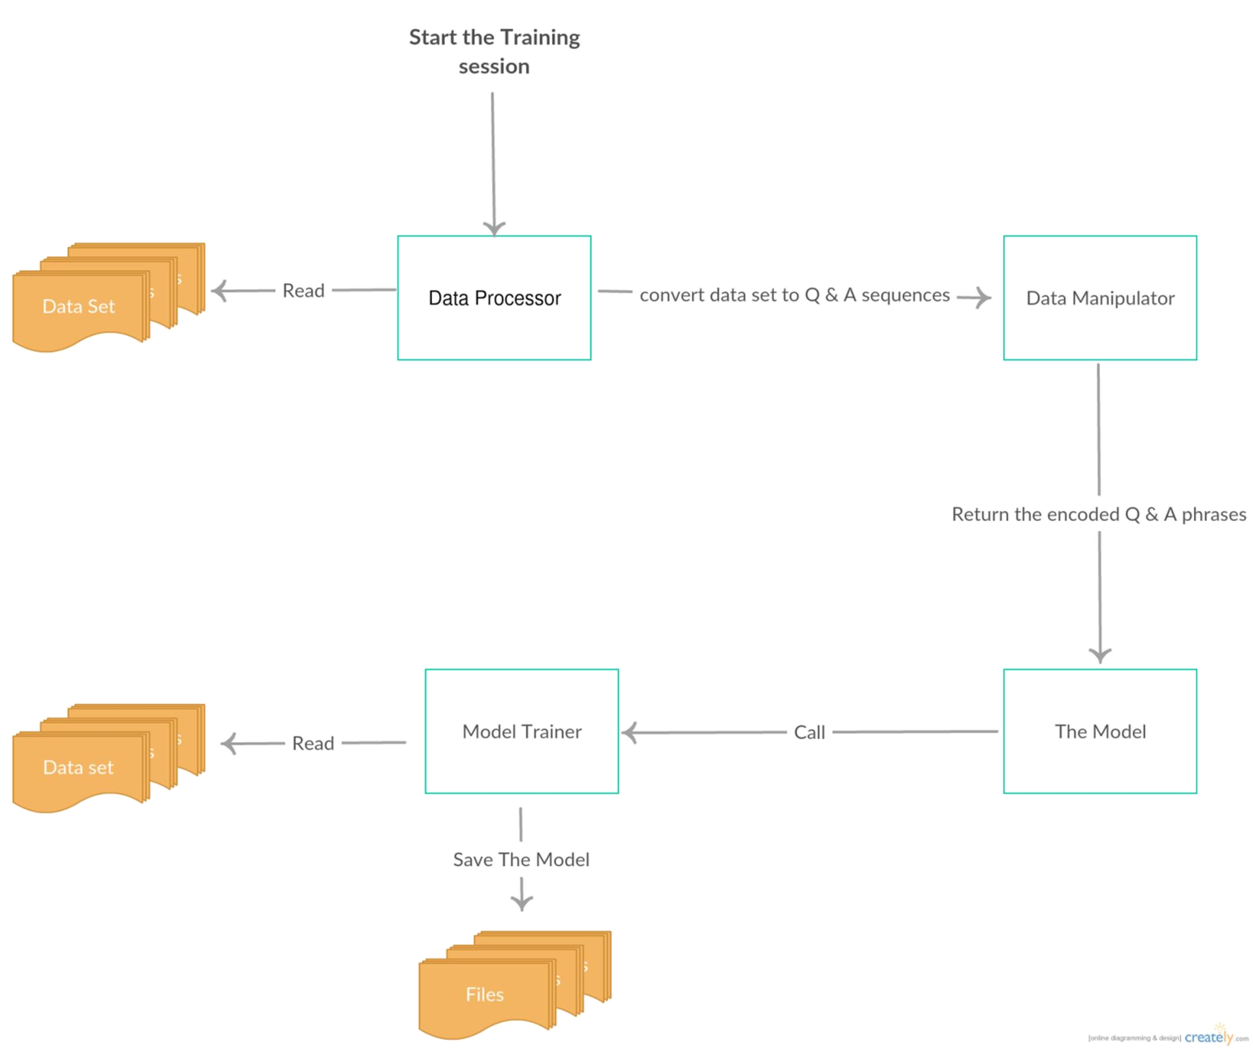
System Architectures: Training

Slide 22
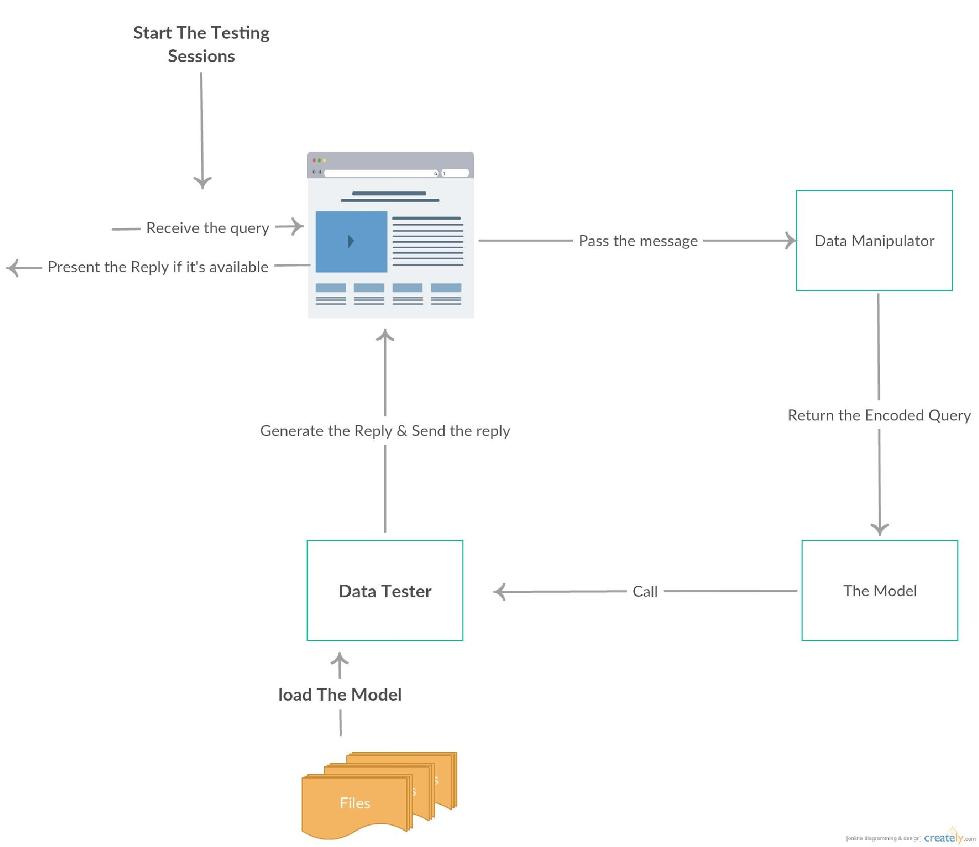
System Architectures: Interactive Testing

Slide 23
Agenda
Introduction
Existing Solutions
System Architectures
Project Modules

Slide 24
Project Modules
Preprocessing.
User Interface

Slide 25
Used Algorithms
What Do We Use?
A sequence-to-sequence model based on a recurrent neural network with long short-term memory.
25

Slide 26
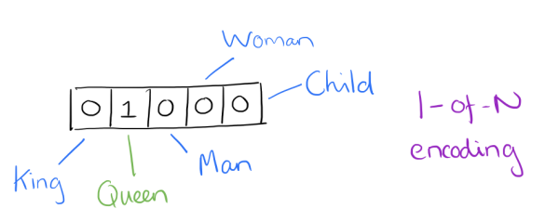
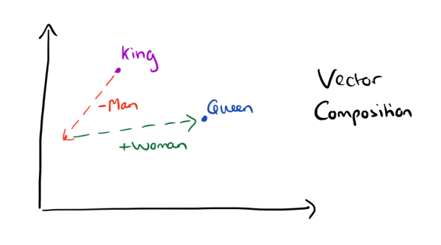
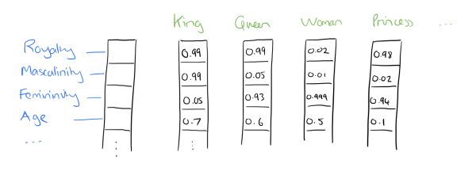
Word representation
Bag of words model.
Word Embedding model.
26
Notes:
2013.
Word2vec: group of related models that are used to produce word embeddings.
These models are shallow, two-layer neural networks that are trained to reconstruct linguistic contexts of words.
Word2vec takes as its input a large corpus of text and produces a vector space,

Slide 27

Recurrent Neural Network (RNN)
27
Notes:
Used in machine translation and language modeling.
Problem:
Pretend the word at last, ex: “there are clouds in the …”
“I grew up in France… I speak fluent French.”
The Problem of Long-Term Dependencies

Slide 28



Long Short-Term Memory(LSTM)
28
Notes:
LSTM created by Sepp Hochreiter (creator of support vector machine) and Jürgen Schmidhuber in 1997
Sigmoid and tanh are activation function

Slide 29
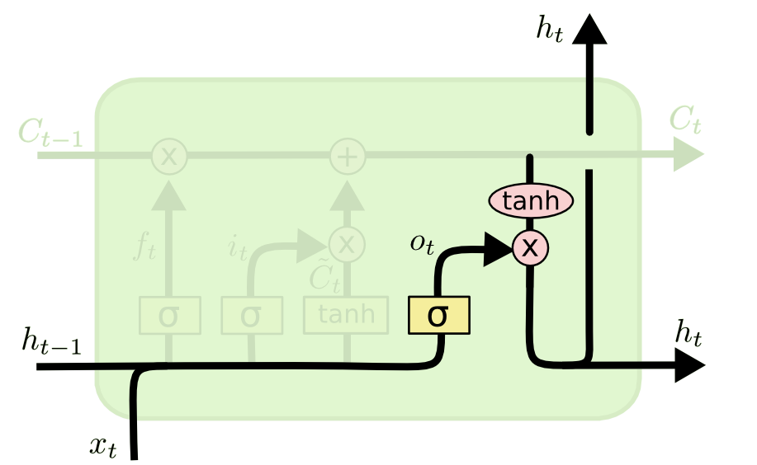
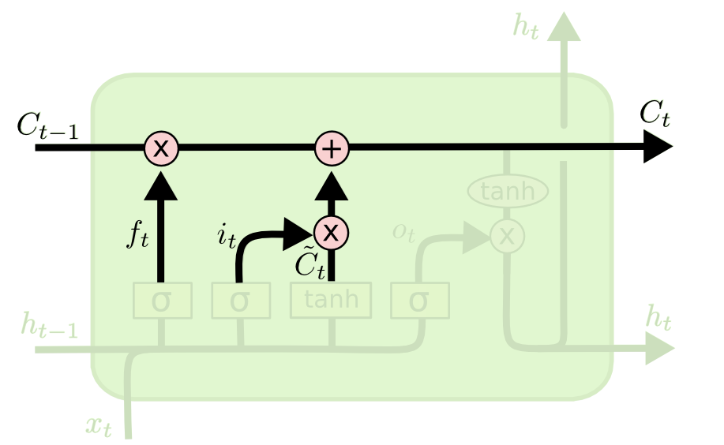
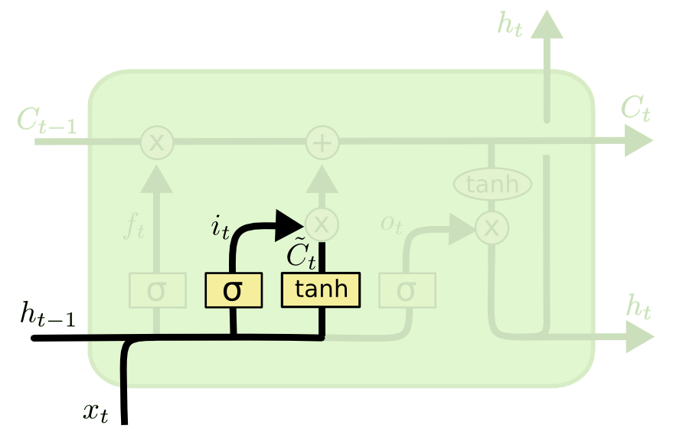
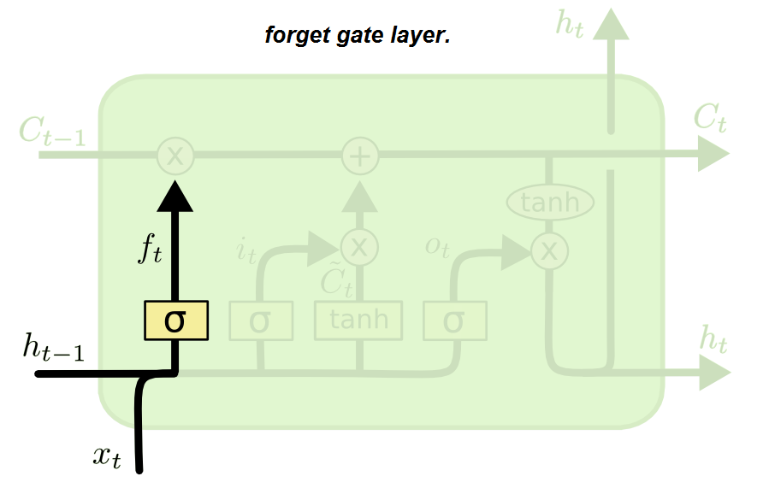
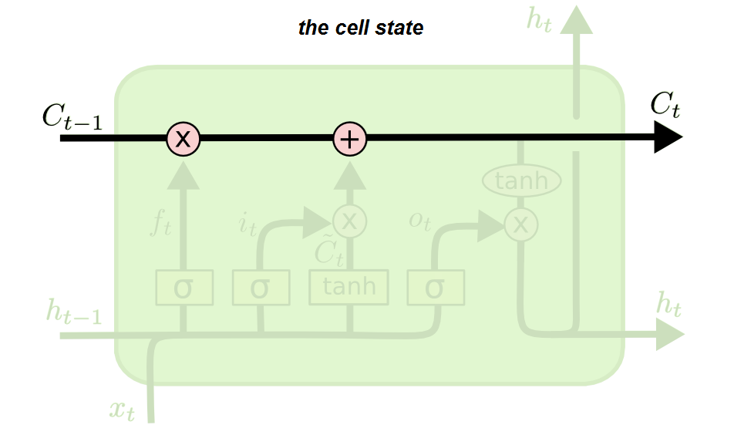
The Core Idea Behind LSTMs
29
Notes:
LSTM created by Sepp Hochreiter (creator of support vector machine) and Jürgen Schmidhuber in 1997
Sigmoid and tanh are activation function

Slide 30
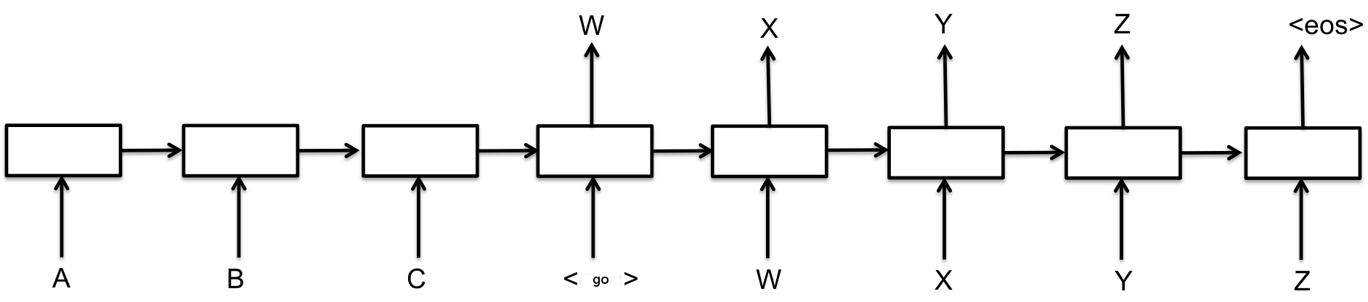
Sequence To Sequence Model(Seq2Seq)
30
Notes:
1- map the input sequence to a fixed-sized vector using one RNN, and then to map the vector to the target sequence with another RNN

Slide 31
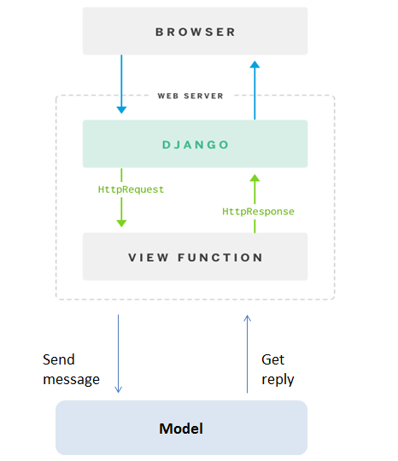
User Interface

Slide 32
Agenda
Introduction
Existing Solutions
System Architectures
Project Modules
Challenges Faced

Slide 33
Challenges Faced
Building a machine learning pipeline from A-Z.
Building a language independent model.
Training using CPU was slow (4 hours per 1 epoch (10 overall)).
Debugging logical errors due to training speed.
Testing the bot accuracy.

Slide 34
Agenda
Introduction
Existing Solutions
System Architectures
Project Modules
Challenges Faced
Future work

Slide 35
Future Work
Producing non-deterministic answers (the network just take the most likely output).
Train on more datasets (e.g: Open Subtitles).
Build a bot that recognizes different users’ personalities, and produce replies based on this property.
Train on real-time conversations.
Publish bot on communications channels (e.g: Messenger, Slack).

Slide 36
Agenda
Introduction
Existing Solutions
System Architectures
Project Modules
Challenges Faced
Future work
Demo

Slide 37
The Demo.

Slide 38


Slide 39
Thank You!

